Slide 1


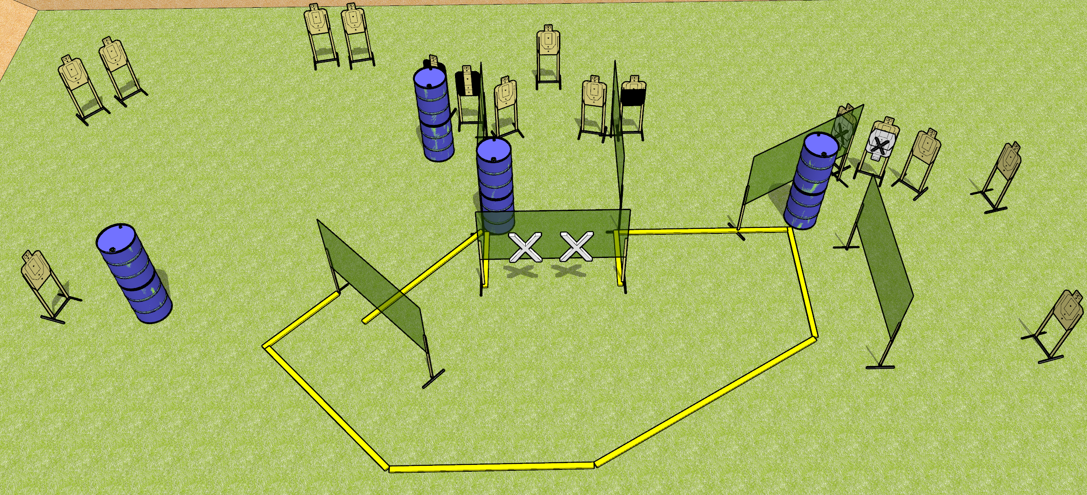
 | Dothan Gun Club – USPSA Match Shortcuts Course Designer : Drew Coleman
START POSITION : Standing with both hands touching wall marked with X’s on diagram (touching anywhere).
GUN READY CONDITION : Pistol loaded and holstered. PCC loaded, held with both hands, shouldered, safety on, muzzle touching the wall marked on the diagram. |  | SCORING: Comstock, 32 rounds TARGETS: 16 paper, 0 Steel SCORED HITS: Best 2 on paper, steel until down START-STOP: Audible, last shot RULES:
STAGE PROCEDURE: Engage targets as they become available from within the fault lines.

Slide 2
Shortcuts
Written Stage Briefing
Shortcuts is a 32 round, 160 point, Comstock field course. There are sixteen USPSA targets. The best two hits on paper will score. The start signal is audible.
Handgun start position is standing with both hands touching the wall marked on the diagram. Pistol is loaded and holstered.
PCC start position is standing with muzzle touching the wall marked on the diagram. Loaded carbine is held with both hands, safety on.
On start signal, engage targets as they become available from within the shooting area

